Slide 1




NEXT GEN EMPLOYABILITY PROGRAM
Creating a future-ready workforce
Team Members
Student Name : MD Suhaib V
Student ID : au311121205036
NM ID: C0386B3CA0E171FA1AA495F760EC9E82
College Name
LOYOLA - ICAM COLLEGE OF ENGINEERING AND TECHNOLOGY

Slide 2

CAPSTONE PROJECT SHOWCASE
Project Title
MUSIC WEB APPLICATION USING DJANGO FRAMEWORK
Abstract | Problem Statement | Project Overview | Proposed Solution | Technology Used | Modelling & Results | Conclusion

Slide 3
Abstract
A music streaming application offers access to an extensive catalog of songs from various artists, genres, and albums, allowing users to explore and enjoy music from anywhere in the world.
Users can access the streaming service from any device with an internet connection, providing seamless listening experiences across different platforms.
Unlike traditional music playback methods, streaming applications consume minimal resources, making them environmentally friendly and cost-effective for both users and service providers.
Streaming applications leverage the speed of internet connections to deliver instant access to millions of songs, ensuring smooth playback without the need for lengthy downloads or buffering.
With access to an extensive library of songs and soundtracks, users can discover new music, revisit old favorites, and explore diverse genres, catering to their individual preferences and tastes.
Music streaming applications provide real-time access to the latest releases and trending tracks, ensuring that users stay up-to-date with the latest music trends and developments.
Users can create personalized playlists, customize their listening experience with advanced features like shuffle and repeat, and receive tailored recommendations based on their listening history and preferences.
Source : Wikipedia

Slide 4
Problem Statement
Despite the vast array of music available today, music enthusiasts often face challenges in discovering new artists, exploring diverse genres, and accessing their favorite tracks seamlessly across different devices. Traditional music playback methods such as physical media or digital downloads are often cumbersome, limiting, and lack real-time updates. Additionally, the fragmentation of music libraries across various platforms can lead to a fragmented user experience, making it difficult for users to curate and enjoy their music collections effectively. As a result, there is a need for a comprehensive music streaming platform that offers universal access to an extensive catalog of songs, provides seamless cross-device compatibility, and enhances the overall listening experience through personalized recommendations and social integration.
Source :

Slide 5
Project Overview
The project aims to develop a robust and user-friendly music streaming platform named "Melodio." Melodio will offer a vast collection of songs from various genres, artists, and albums, allowing users to discover, explore, and enjoy their favorite music effortlessly. The platform will provide seamless access to music across different devices, including desktops, laptops, tablets, and smartphones, ensuring a consistent user experience regardless of the device used. Melodio will prioritize user engagement and satisfaction by implementing features such as personalized recommendations, social sharing functionalities, and user-generated playlists. The platform will also focus on enhancing music discovery through intelligent algorithms that analyze user preferences and behavior to suggest relevant content. Overall, Melodio aims to revolutionize the way people consume and interact with music, offering a comprehensive and immersive music streaming experience.
Source :

Slide 6
Proposed Solution
The proposed solution for the music streaming application, Melodio, involves the development of a sophisticated web and mobile platform equipped with advanced features to cater to the diverse needs of music enthusiasts. Key components of the solution include:
User-Friendly Interface: Implementing an intuitive and visually appealing user interface across web and mobile platforms to enhance user experience and engagement.
Vast Music Library: Curating an extensive collection of songs spanning various genres, artists, albums, and languages to cater to diverse user preferences.
High-Quality Audio Streaming: Providing high-quality audio streaming with support for different audio formats and bitrates to deliver an immersive listening experience.
Offline Playback: Enabling users to download their favorite songs for offline playback, allowing them to enjoy music even without an internet connection.
Source :

Slide 7
Personalized Recommendations: Integrating machine learning algorithms to analyze user behavior, preferences, and listening history to provide personalized song recommendations and curated playlists.
Seamless Cross-Platform Experience: Ensuring seamless access to Melodio across different devices and platforms, including web browsers, iOS, and Android devices, allowing users to enjoy uninterrupted music streaming anytime, anywhere.
Social Features: Incorporating social sharing functionalities, user-generated playlists, and collaborative playlist creation to foster community engagement and interaction among users.
Robust Backend Infrastructure: Building a scalable and reliable backend infrastructure using cloud-based services to ensure optimal performance, scalability, and security of the platform.
Listen later functionality for each user when logged in.
Source :

Slide 8


Technology Used
Front-end
Back-end
Source :

Slide 9
Modelling & Results
Data Model: Developed a comprehensive data model to represent various entities such as users, songs, albums, artists, genres, etc.. Utilized Django ORM for defining models and establishing relationships between entities.
System Architecture: Designed a scalable and robust system architecture comprising frontend and backend components. Implemented a RESTful API using Django REST Framework to handle requests and responses efficiently.
Technology Stack: Leveraged Python Django framework for backend development, HTML/CSS/JavaScript for frontend UI, and MySQL database for data storage.
Testing and Validation: Conducted thorough testing across multiple stages, including unit testing, integration testing, and user acceptance testing (UAT).
Performance Metrics: Achieved low response times and high throughput, ensuring smooth and responsive user experience. Monitored performance metrics such as response time, latency, and system availability using monitoring tools like Prometheus and Grafana.
Source :

Slide 10
Modelling & Results
Scalability: Demonstrated the application's scalability by handling a large number of concurrent users and scaling resources dynamically based on demand. Implemented horizontal scaling using containerization with Docker and orchestration with Kubernetes for managing application instances.
User Feedback: Received positive feedback from users regarding the application's intuitive user interface, seamless navigation, and extensive music catalog. Incorporated user feedback to make iterative improvements and enhance user satisfaction.
Future Directions: Identified areas for future enhancement, including implementing personalized recommendations, integrating social features for user engagement, expanding the music catalog through partnerships with record labels, and optimizing performance further through caching strategies and performance tuning.
Source :

Slide 11
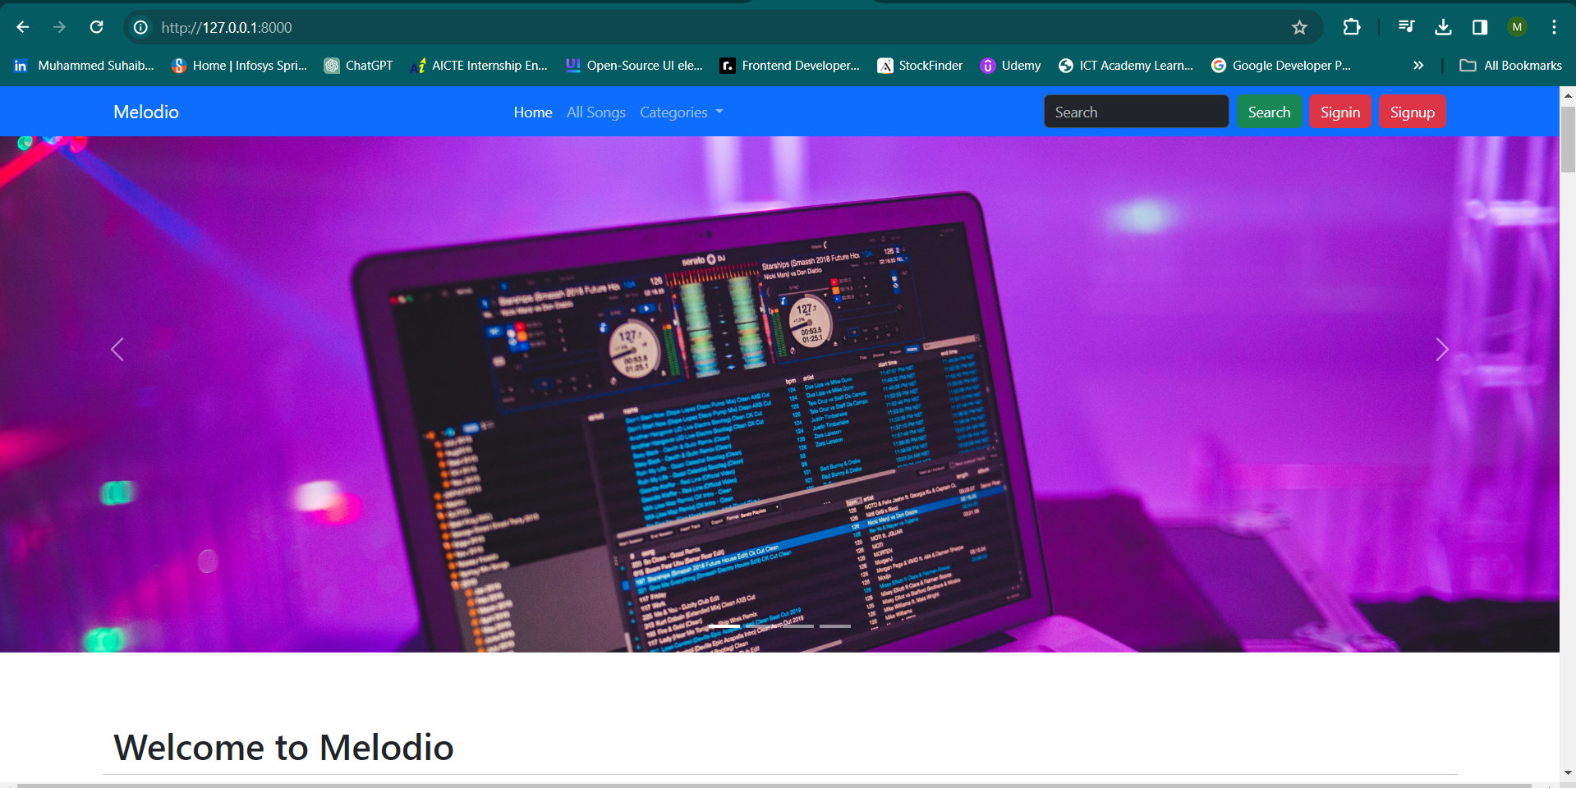
Homepage

Slide 12
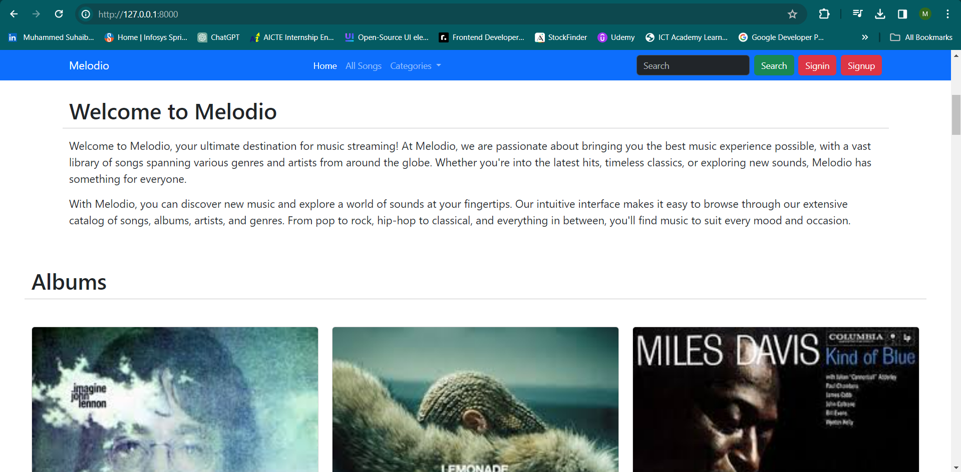
Homepage

Slide 13
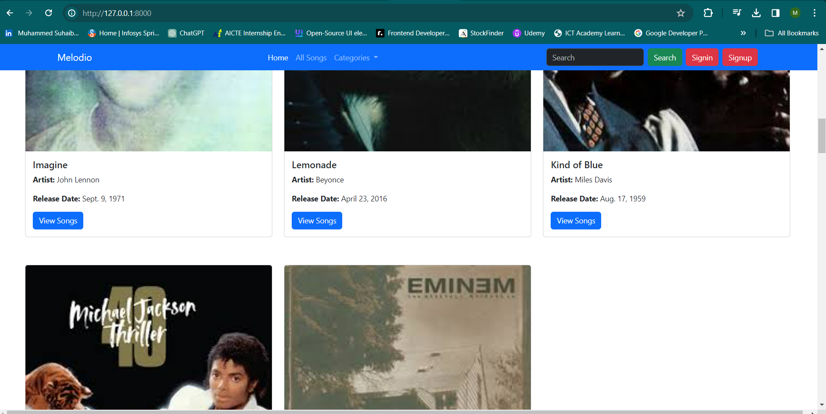
Homepage

Slide 14
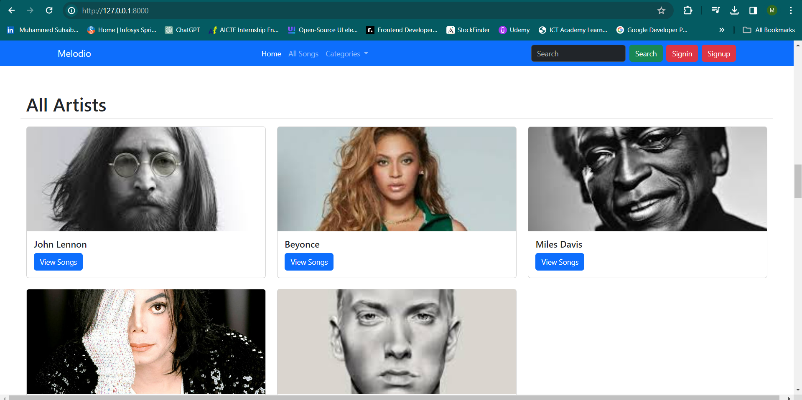
Homepage

Slide 15
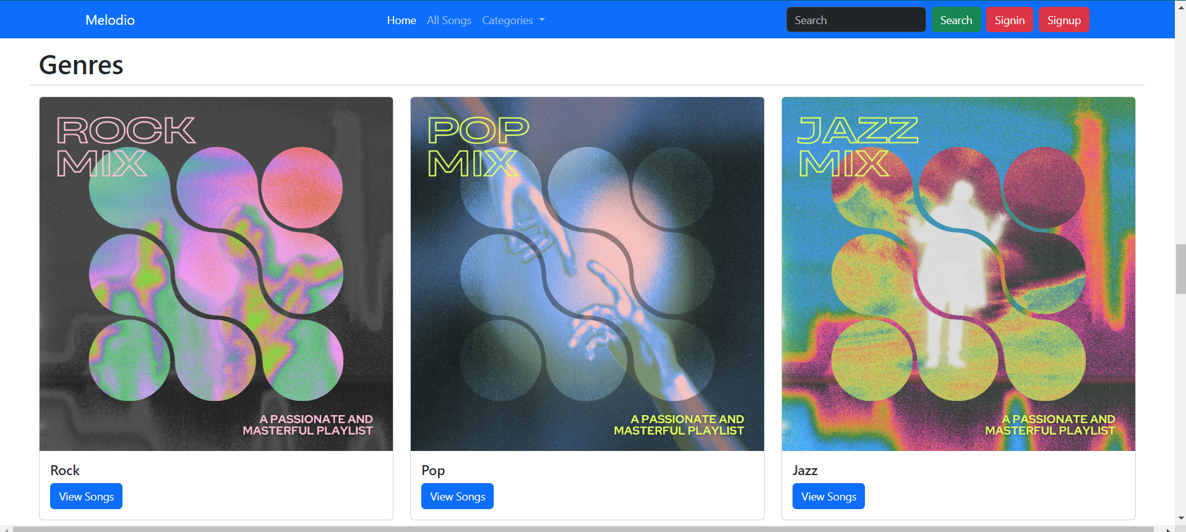
Homepage

Slide 16
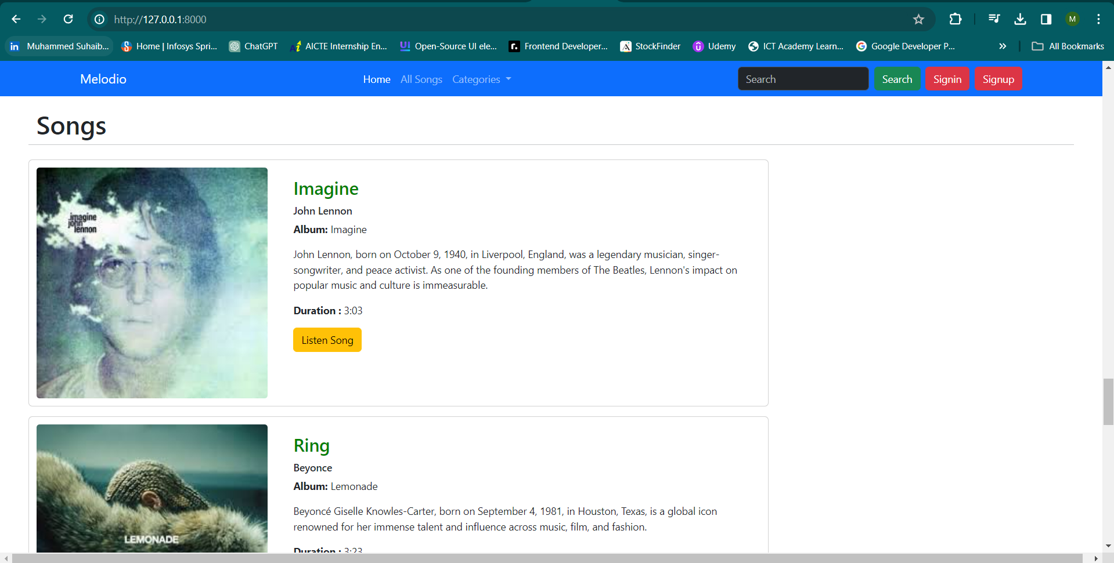
Homepage

Slide 17
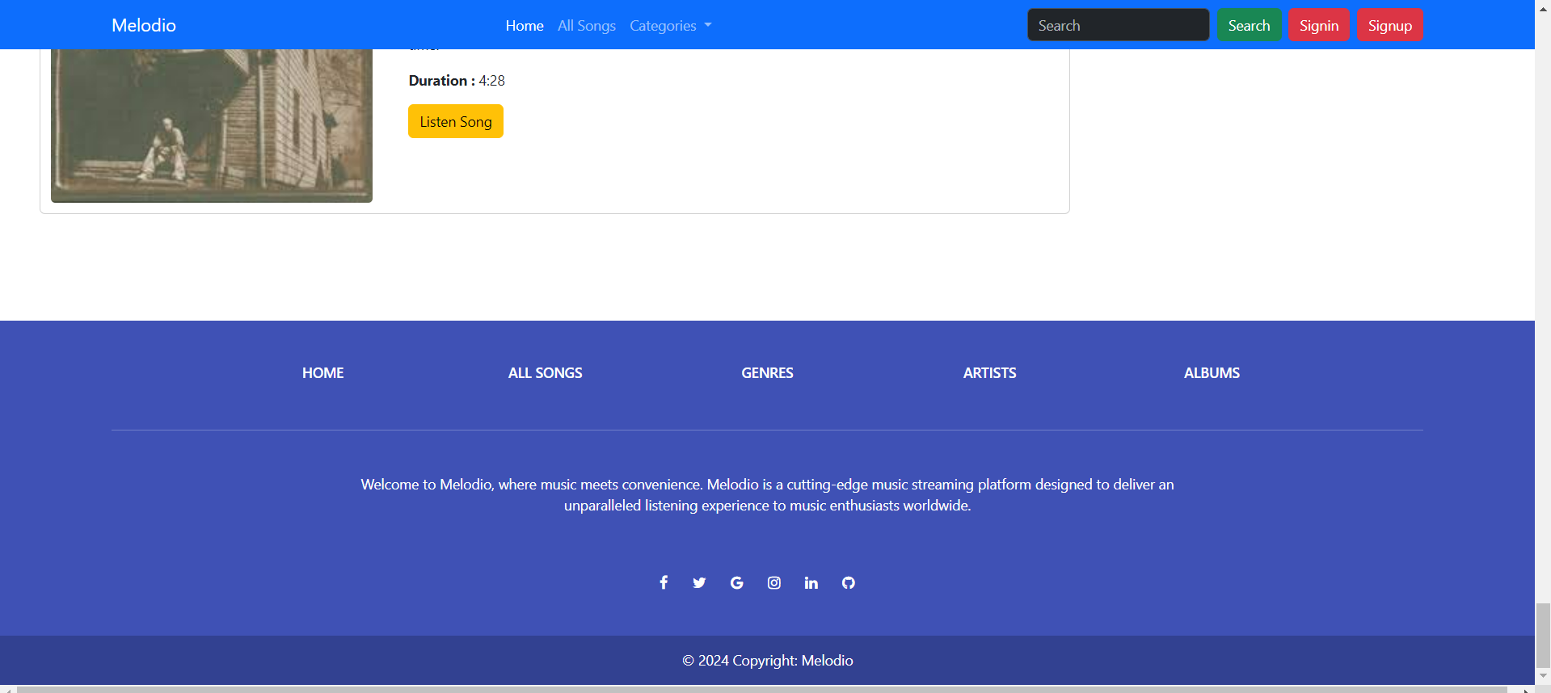
Homepage

Slide 18
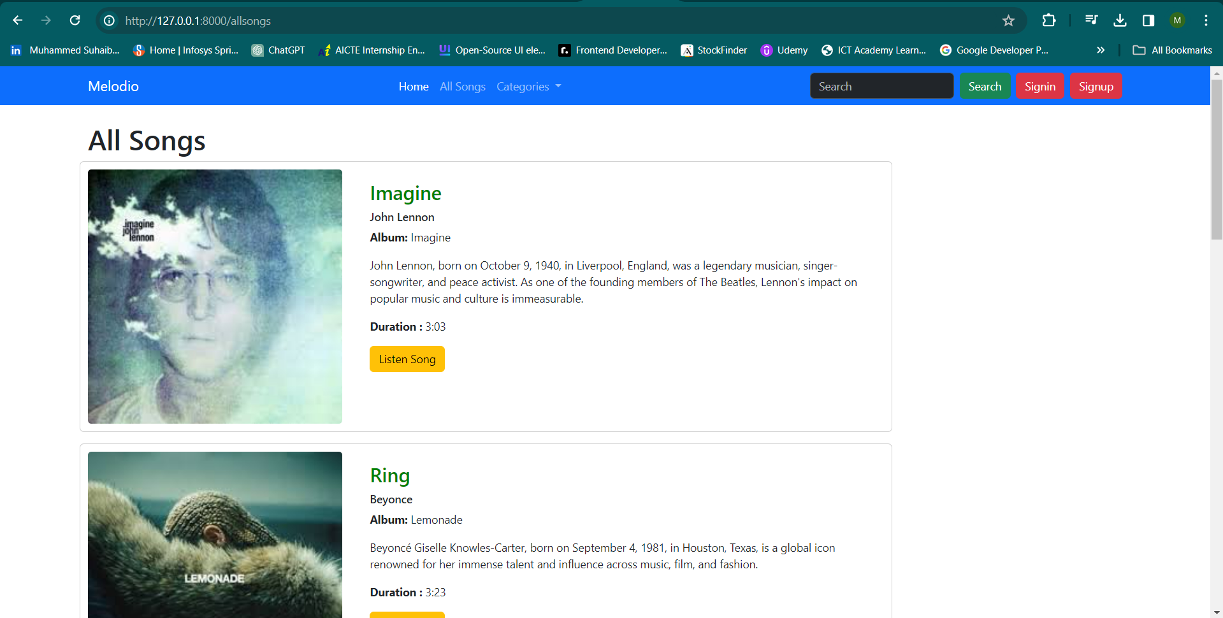
All-Songs-Page

Slide 19
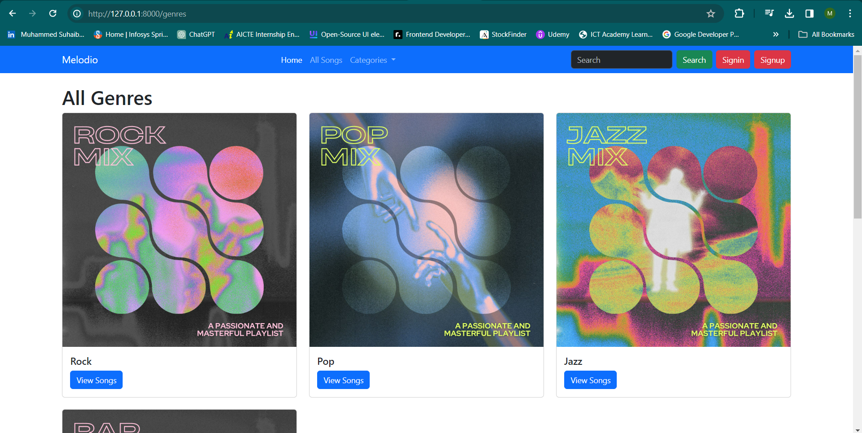
Genres-Page

Slide 20
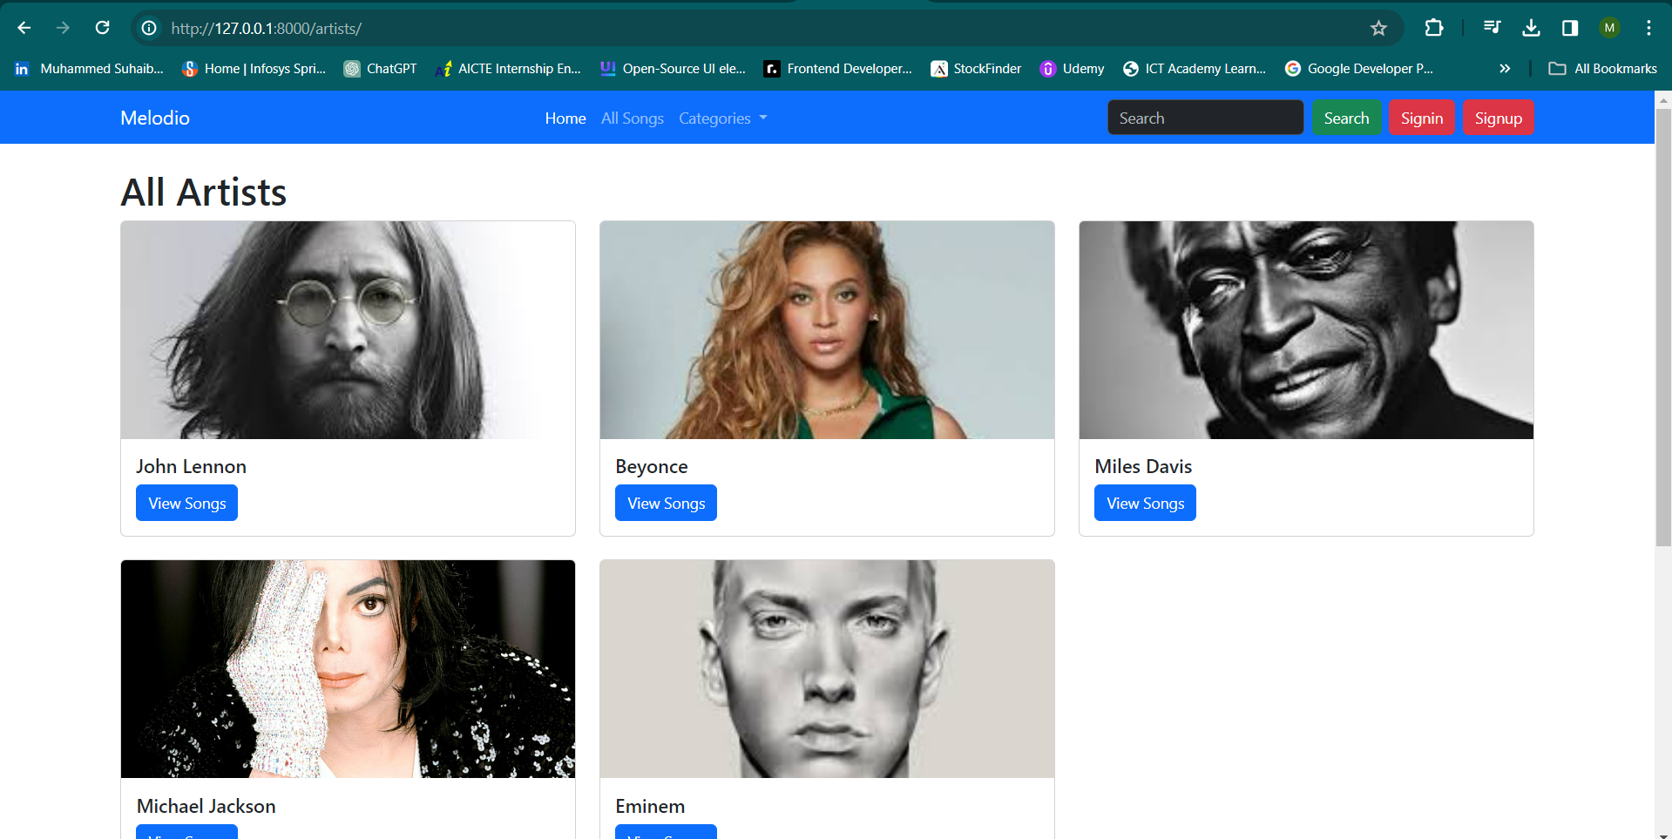
Artists-Page

Slide 21
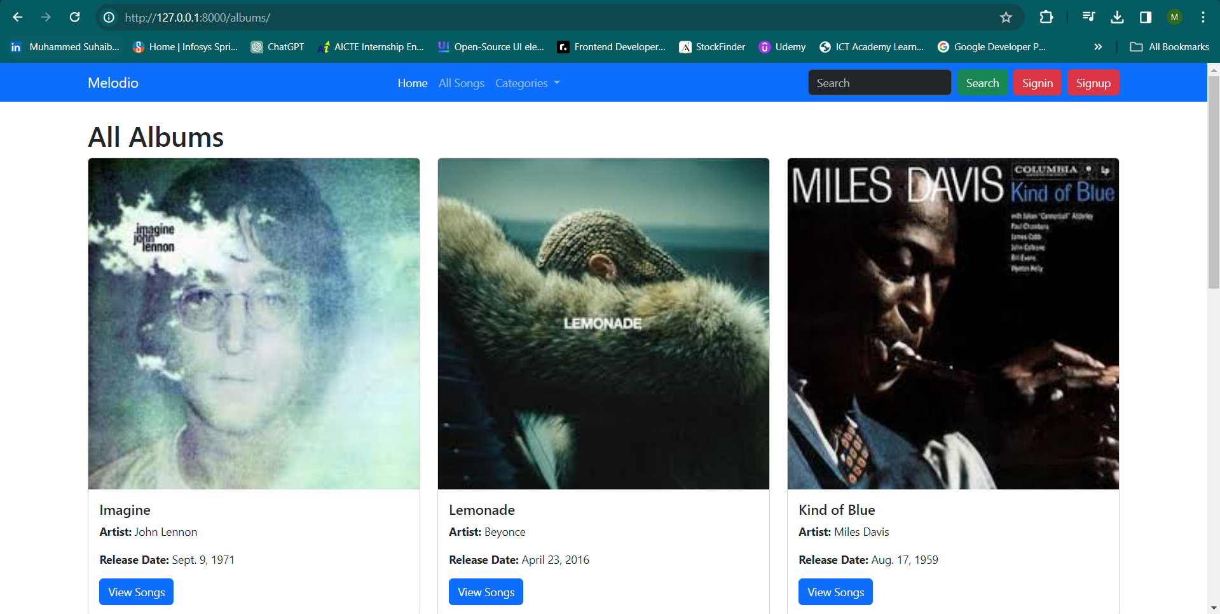
Albums-Page

Slide 22
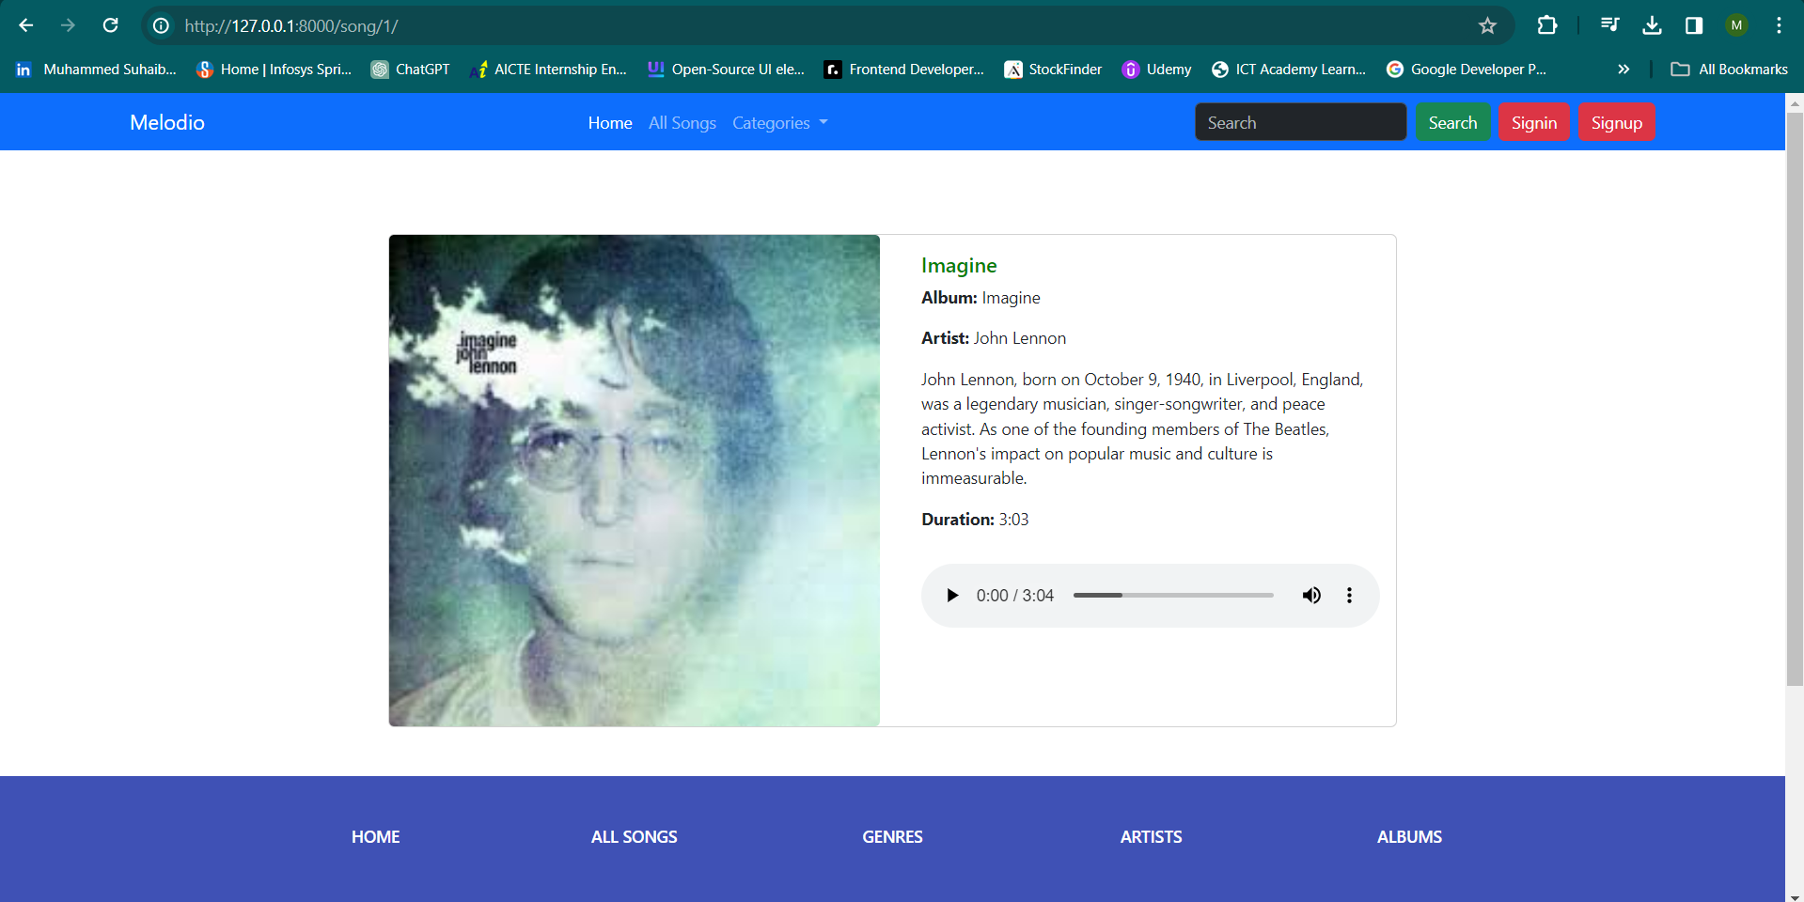
Listen-Song-Page

Slide 23
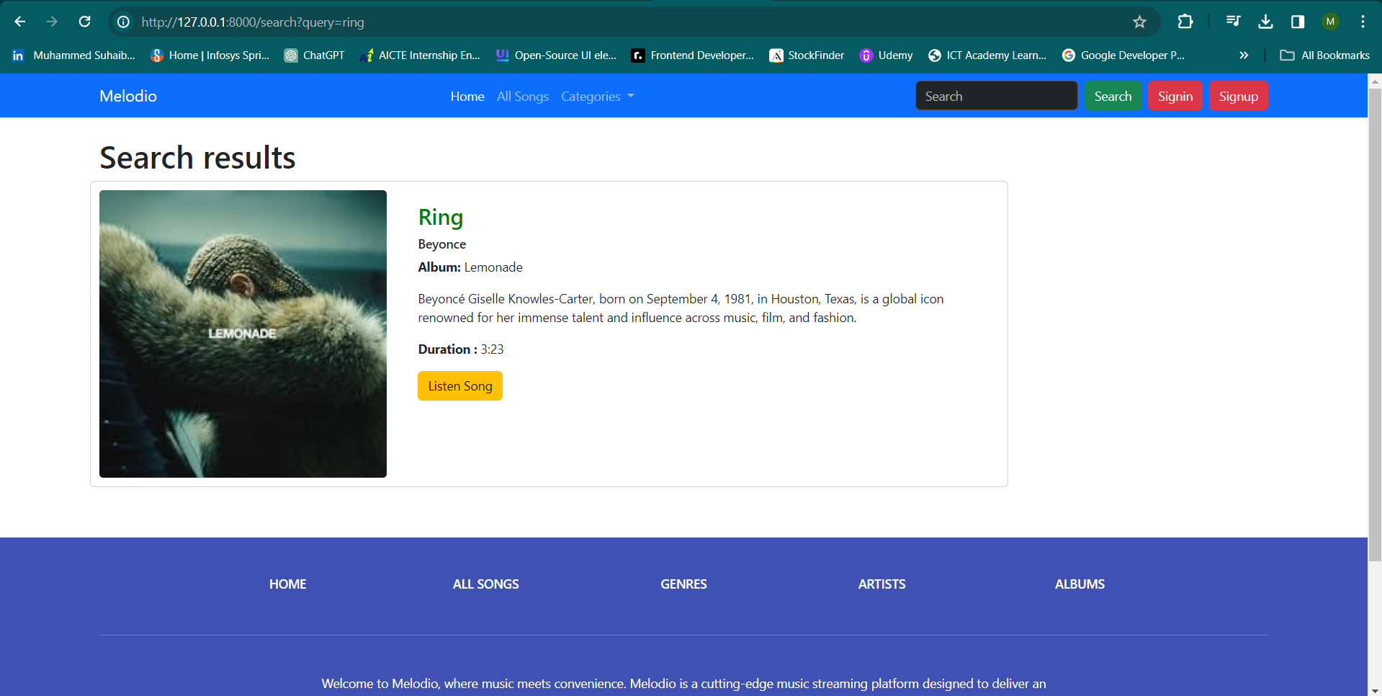
Search-Result-Page

Slide 24
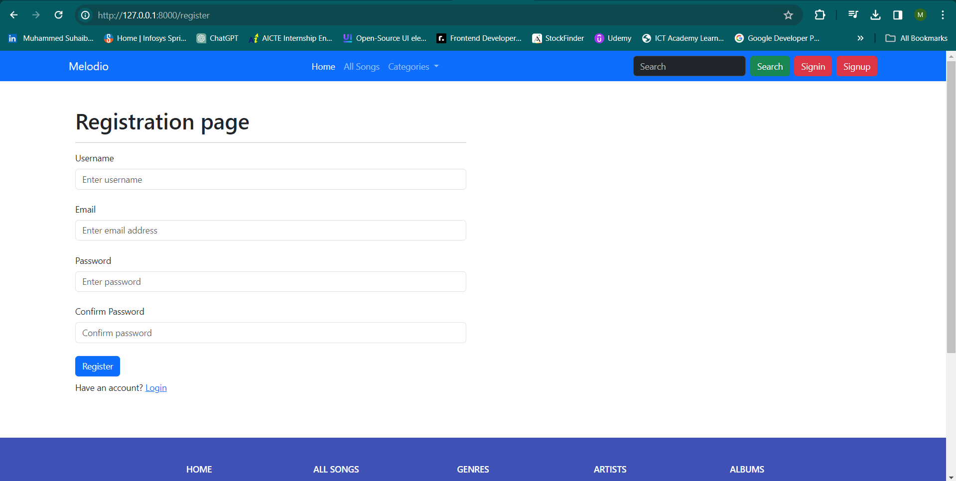
Registration-Page

Slide 25
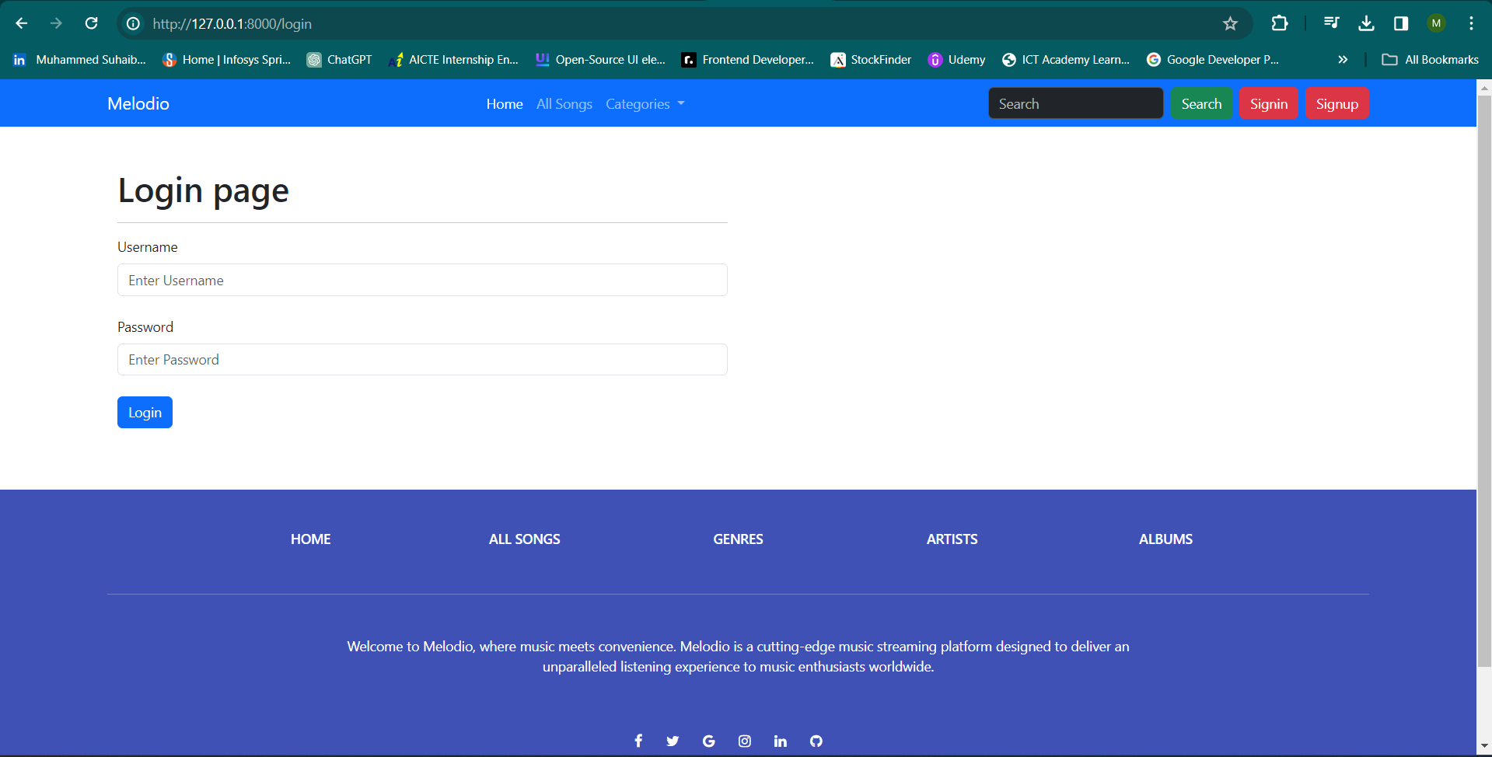
Login-Page

Slide 26
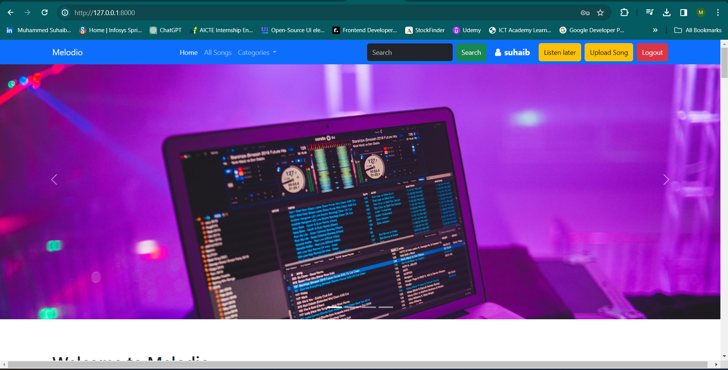
Home after login-Page

Slide 27
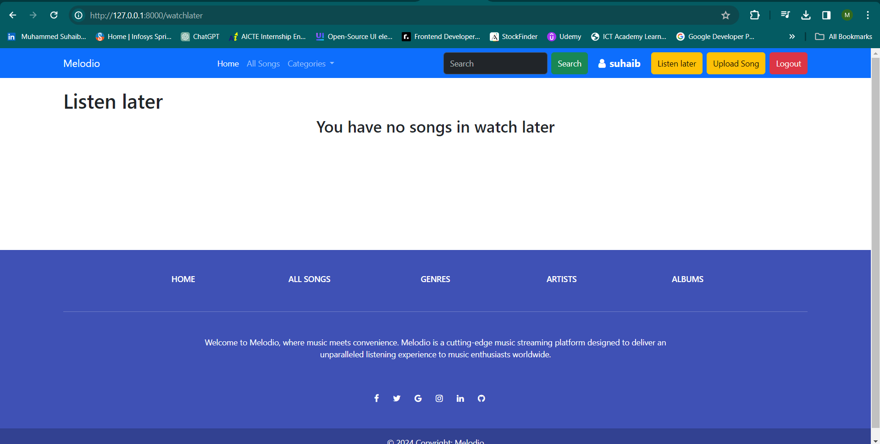
Listen later-Page

Slide 28
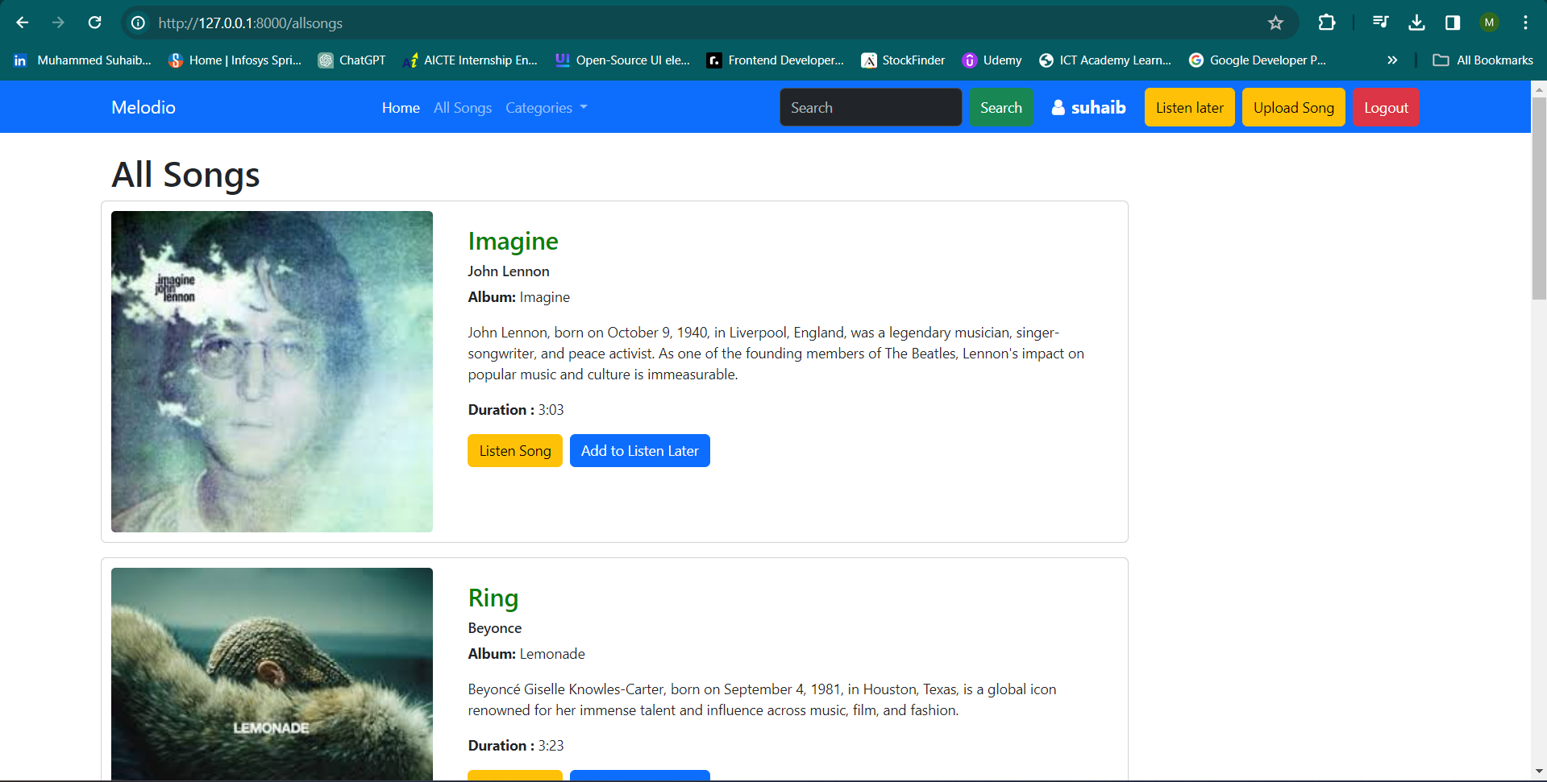
Listen later-Page

Slide 29
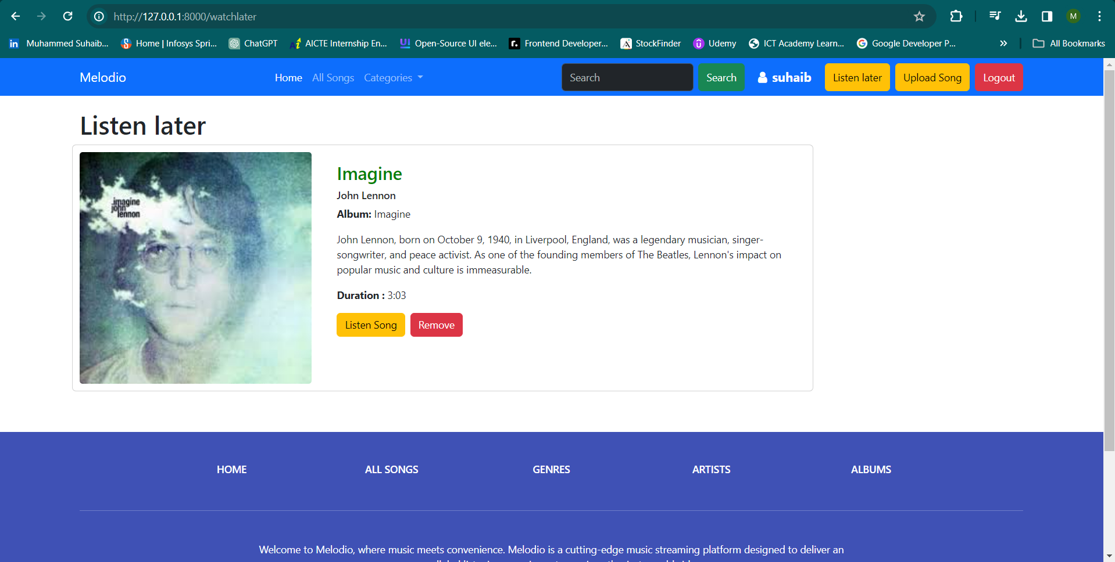
Listen later-Page

Slide 30
Future Enhancements:
Personalized Recommendations: Implement machine learning algorithms to analyze user preferences and behavior, providing personalized song recommendations, playlists, and curated content tailored to each user's taste.
Social Integration: Integrate social features such as user profiles, friend connections, and social sharing capabilities to enhance user engagement and facilitate social interactions within the platform. Users can follow friends, share playlists, and discover music based on their social network activity.
Enhanced Discovery Features: Enhance the discovery experience with advanced search filters, mood-based playlists, and intelligent recommendations based on contextual factors like time of day, location, and activity. Implement features such as "Discover Weekly" playlists and genre-based radio stations to help users explore new music.
Podcasts and Audio Content: Expand the platform beyond music by incorporating podcasts, audiobooks, and other audio content. Allow users to discover, subscribe to, and listen to a wide range of audio content across different genres and categories.
Live Streaming and Events: Incorporate live streaming capabilities to broadcast concerts, music festivals, and exclusive live events directly within the platform. Enable users to access live performances from their favorite artists and bands, creating an immersive and interactive experience.

Slide 31
Conclusion
In conclusion, the development of this music streaming application represents a significant advancement in the digital entertainment industry, providing users with a seamless and immersive platform to discover, stream, and enjoy music from a vast library of songs and artists. Through innovative features such as personalized recommendations, social integration, and offline playback, the application aims to enhance the overall music listening experience for users, catering to their diverse preferences and preferences.
With its user-friendly interface, robust backend infrastructure, and continuous commitment to technological innovation, the music streaming application is poised to become a leading player in the competitive market of digital music platforms. By leveraging emerging technologies, embracing user feedback, and staying attuned to industry trends, the platform will continue to evolve and adapt to meet the changing needs and expectations of its user base.
As we look towards the future, the music streaming application remains dedicated to delivering high-quality audio content, fostering community engagement, and enriching the lives of music enthusiasts worldwide. With a steadfast commitment to excellence and a passion for innovation, the application is poised to redefine the way people discover, consume, and interact with music in the digital age.
Source :

Slide 32
Thank You!
Notes:
Thank You !!

